Slide 1


Spatial computing: a unifying approach to computational materials
Jacob Beal
Royal Society Meeting on Heterotic Computing
November, 2013

Slide 2
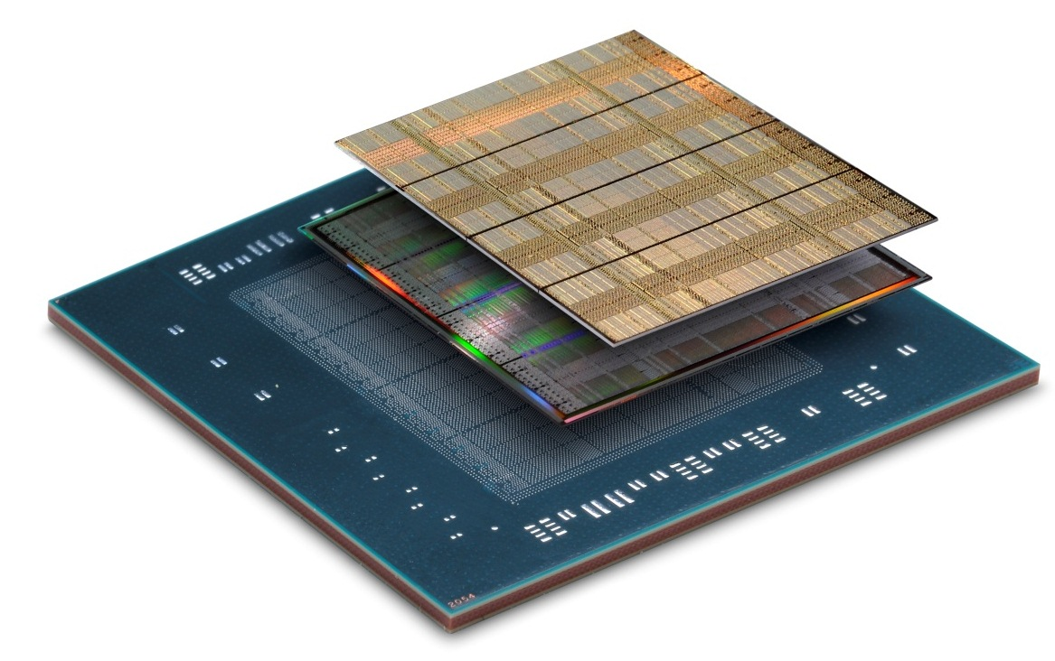
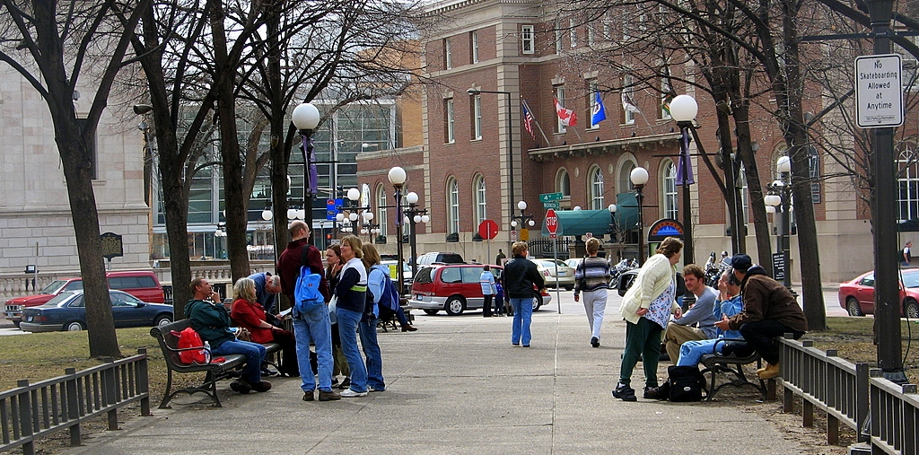
Computing runs across physical space-time
Emerging Computational Substates
Space-Time
Programming Models
Multi-Substrate Computation
device
neighborhood

Slide 3
Outline
From Monolithic to Spatial Computing
Amorphous Medium & Field Calculus
Biological / Hybrid Computational Substrate

Slide 4
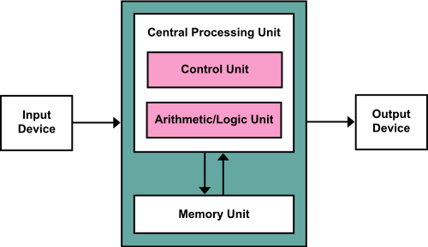
Traditional Monolithic Computing
The venerable von Neumann model is
breaking down in several ways…

Slide 5
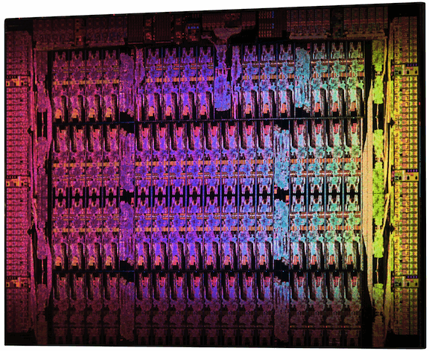
The End of Moore’s Law
Intel Xeon Phi: 61 cores
Xilinx Virtex-7: 2M Logic cells
High-performance computing = mesh

Slide 6
Everything is a wireless computer

Slide 7
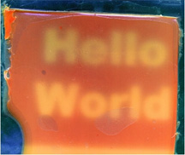
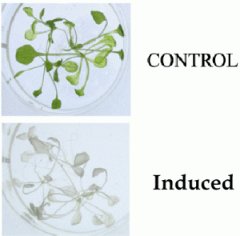

New Computational Materials
Synthetic Biology:
[Levskaya]
[Weiss]
[Medford]
[Hasty]
Other emerging areas too, including nanoassembly, active materials…

Slide 8

Fundamentally different models
Isolate Systems
Extremely High FLOPs
High Dispersion
Moderate FLOPs
High Resolution Sense/Act
Abysmal FLOPs
How can we program aggregates adaptively & efficiently?
Can mixed systems exploit platform complementarity?
Notes:
(e.g., biosensors talk bootstrap off cheap wireless talks to talk to cloud computation

Slide 9
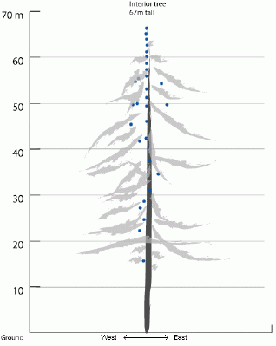
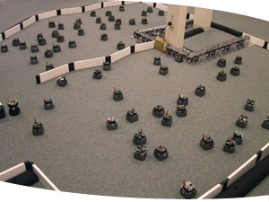
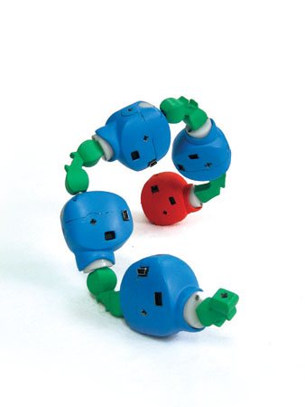
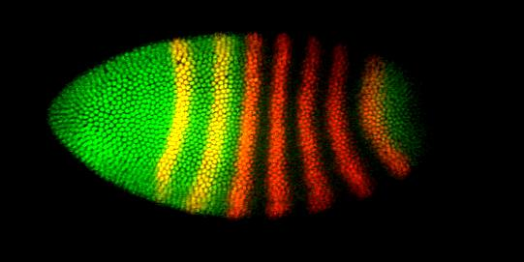
Spatial Computers
Biological Computing
Sensor Networks
Robot Swarms
Modular Robotics
Cells during Morphogenesis
Reconfigurable Computing

Slide 10
More formally...
A spatial computer is a collection of computational devices distributed through a physical space in which:
the difficulty of moving information between any two devices is strongly dependent on the distance between them, and
the “functional goals” of the system are generally defined in terms of the system's spatial structure

Slide 11
Outline
From Monolithic to Spatial Computing
Amorphous Medium & Field Calculus
Biological / Hybrid Computational Substrate

Slide 12
Amorphous Medium
device
neighborhood
Continuous space & time
Infinite number of devices
See neighbors' past state
Approximate with:
Discrete network of devices
Signals transmit state
[Beal, ’04]
Notes:
Note that there is a duality between the manifold and the network: either we want a particular manifold, and we look for a network that approximates it well, or we have a network and we look for a manifold that is approximated well by it.
This is the slide where I should show the simulator running “channel”
./proto -n 1000 -r 10 -rad 1 -l "(all (swim (if (sense 1) (dither) (tup 0 0))) (green (channel (sense 1) (sense 2) 10)))" -s 0.1 -m -S 1

Slide 13
Field Calculus:
Pointwise
Restriction: if
+
restrict
Feedback: rep
Neighborhood: nbr
41
7
delay
+
nbr
any-hood
48
With appropriate pointwise measurements, operations are space-time universal
[Viroli et al., ’13]

Slide 14
Implementation: Proto
(def gradient (src) ...)
(def distance (src dst) ...)
(def dilate (src n)
(<= (gradient src) n))
(def channel (src dst width)
(let* ((d (distance src dst))
(trail (<= (+ (gradient src)
(gradient dst))
d)))
(dilate trail width)))
evaluation
global to local
compilation
Global Local Discrete
platform
specificity &
optimization
device
neighborhood
discrete
approximation
Device
Kernel
[Beal & Bachrach, '06]

Slide 15
Heterogeneous Computing Materials
Functional “streams” integrate different time scales

Slide 16
Outline
From Monolithic to Spatial Computing
Amorphous Medium & Field Calculus
Biological / Hybrid Computational Substrate

Slide 17
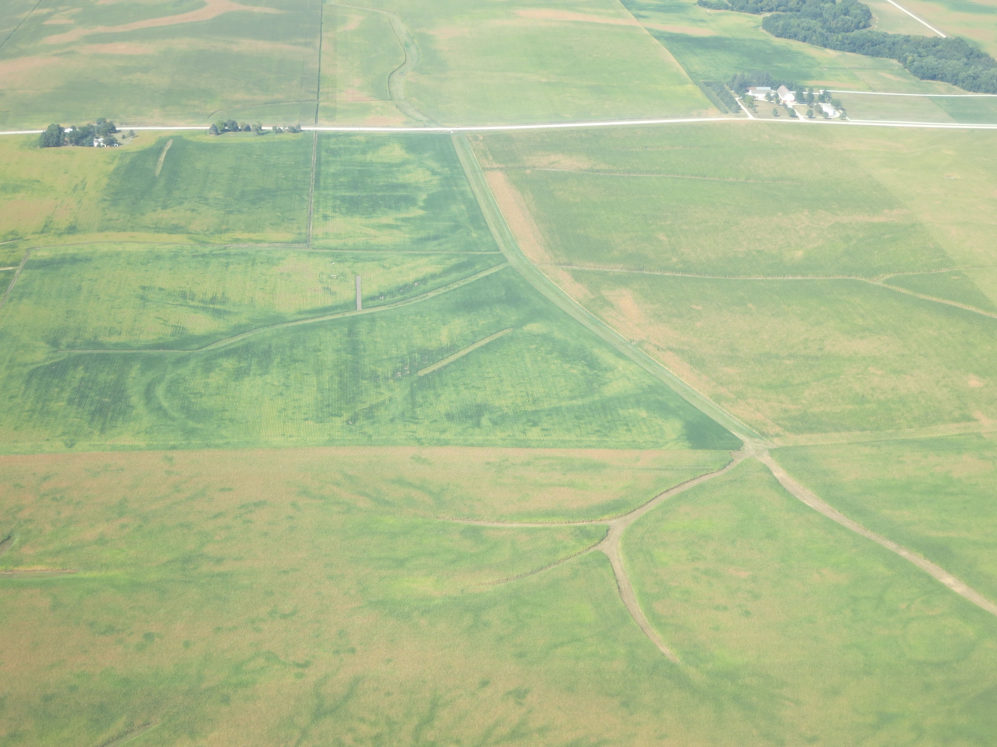
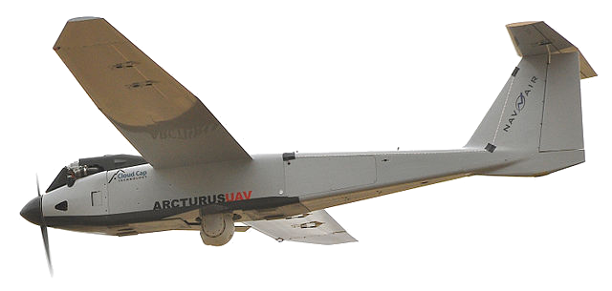
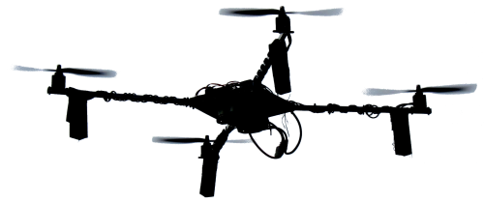
Vision: Precision Crop Management
!!!

Slide 18
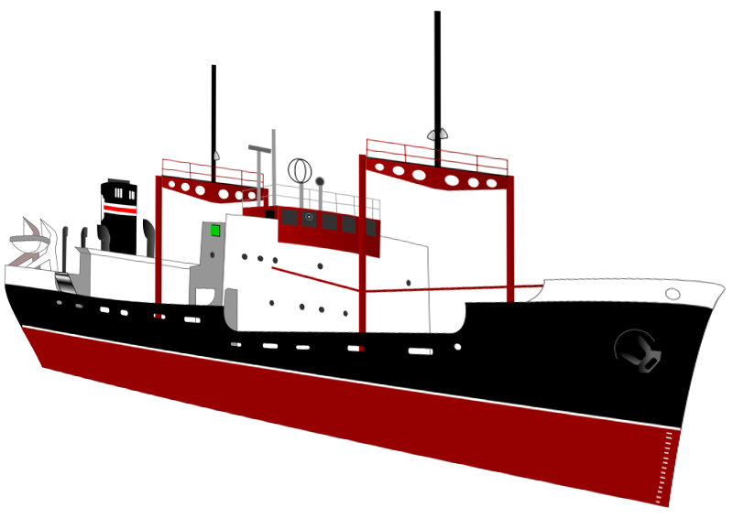
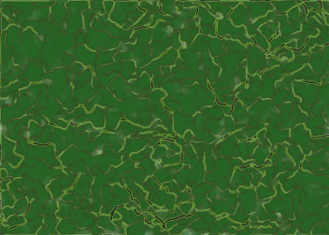
Application: Protective Biofilms
Continuously grown
and shed outer layer
Secure base layer tracks state, coordinates reactive emission of defensive chemicals
Hull
Embedded electronic
monitoring interface

Slide 19
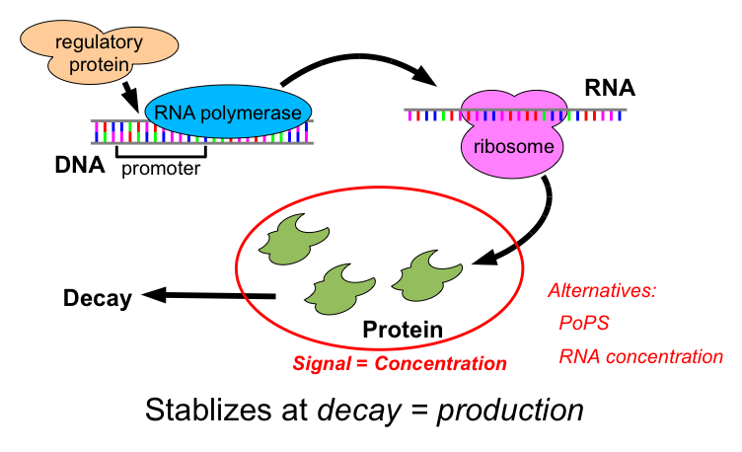
Synthetic Biology: Transcriptional Logic

Slide 20
Genetic Regulatory Networks
Parallel dataflow computation
Continuous time evolution, feedback loops
Example: SR-Latch
Spatial patterning via intercellular signaling, adhesion, cell morphology, …
IPTG
F
GFP
H
LacI
TetR
aTc
H
F

Slide 21
BioCompiler: Proto → GRN
(green (not (IPTG)))
IPTG
not
green
IPTG
A
B
LacI
outputs
arg0
outputs
arg0
GFP
outputs
IPTG
LacI
A
B
GFP
[Beal, Lu & Weiss, ’11]

Slide 22
Optimization of Complex Designs
(def sr-latch (s r)
(letfed+ ((o boolean (not (or r o-bar)))
(o-bar boolean (not (or s o))))
o))
(green (sr-latch (aTc) (IPTG)))
IPTG
GFP
LacI
B
I
F
E1
E2
D
I
aTc
C
J
H
G
TetR
A
J
IPTG
GFP
H
Final Optimized:
5 functional units
4 transcription factors
F
LacI
TetR
aTc
H
F
Unoptimized: 15 functional units, 13 transcription factors

Slide 23
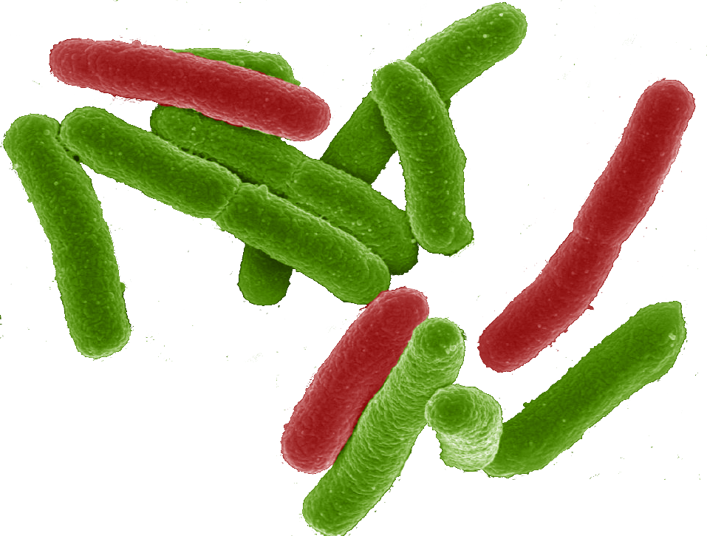

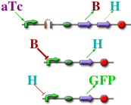
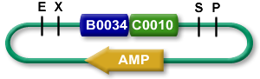
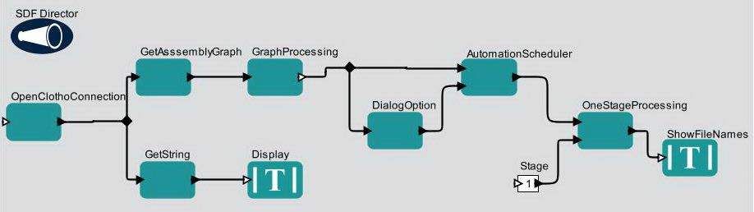
TASBE Tool-Chain
A high-level program of a system that reacts depending on sensor output
If detect explosives:
emit signal
If signal > threshold:
glow red
(def simple-sensor-actuator ()
(let ((x (test-sensor)))
(debug-1 x)
(debug-2 (not x))))
Mammalian Target
E. coli Target
[Beal et al., 2012]

Slide 24
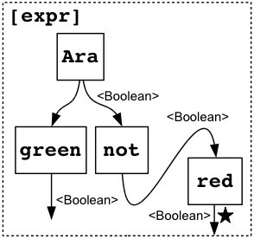
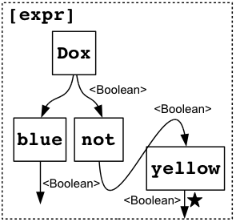
TASBE Tool-Chain
Program instantiated for two target platforms
If detect explosives:
emit signal
If signal > threshold:
glow red
Mammalian Target
E. coli Target
[Beal et al., 2012]

Slide 25
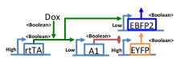
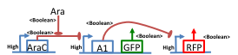
TASBE Tool-Chain
Abstract genetic regulatory networks
If detect explosives:
emit signal
If signal > threshold:
glow red
Mammalian Target
E. coli Target
[Beal et al., 2012]

Slide 26
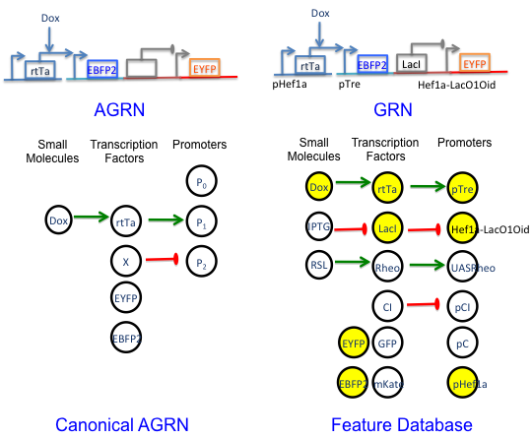
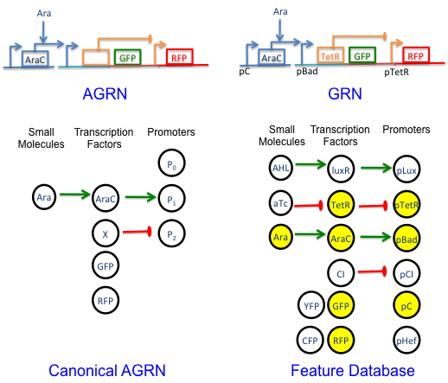
TASBE Tool-Chain
Automated part selection using database of known part behaviors
If detect explosives:
emit signal
If signal > threshold:
glow red
Mammalian Target
E. coli Target
[Beal et al., 2012]

Slide 27
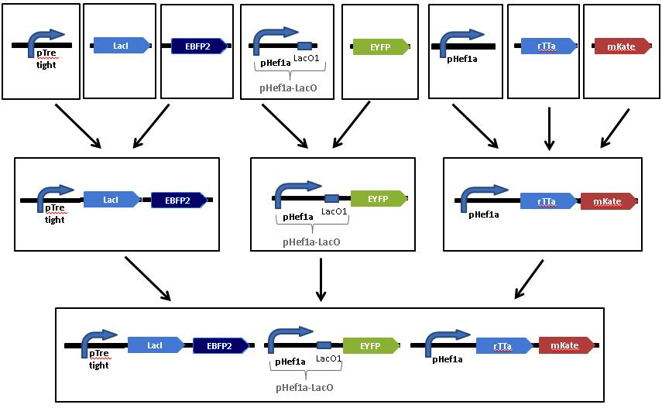
TASBE Tool-Chain
Automated assembly step selection for two different platform-specific assembly protocols
If detect explosives:
emit signal
If signal > threshold:
glow red
Mammalian Target
E. coli Target
[Beal et al., 2012]

Slide 28
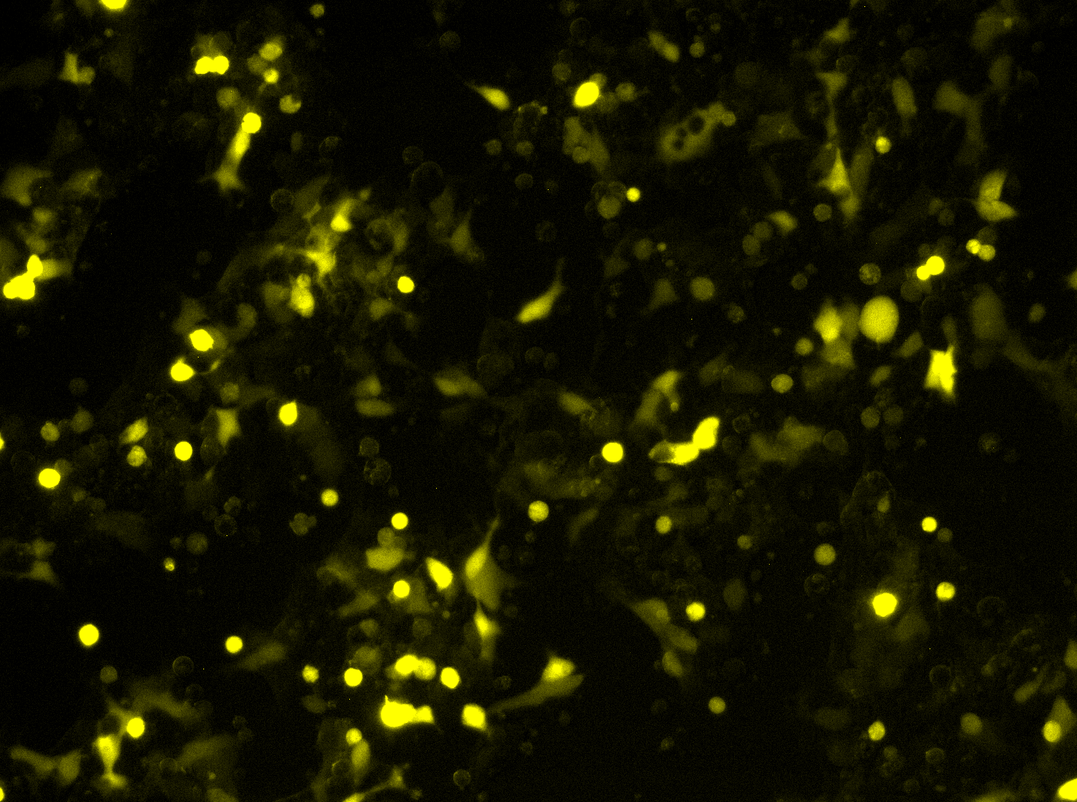
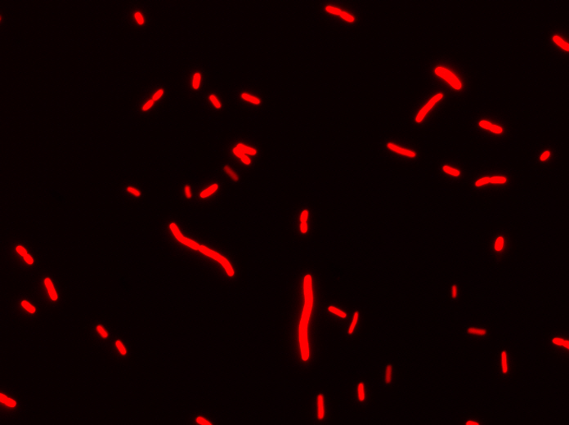
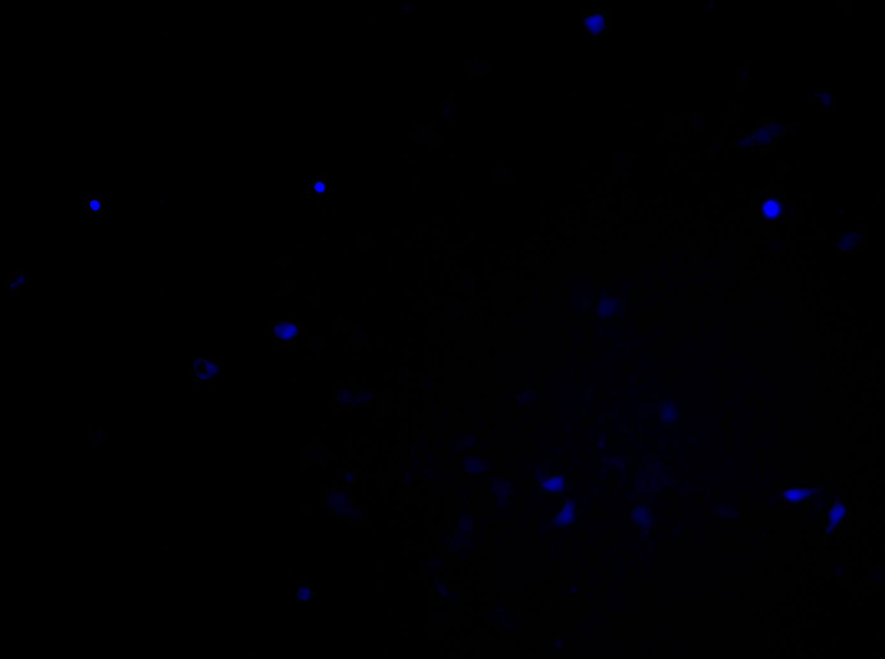
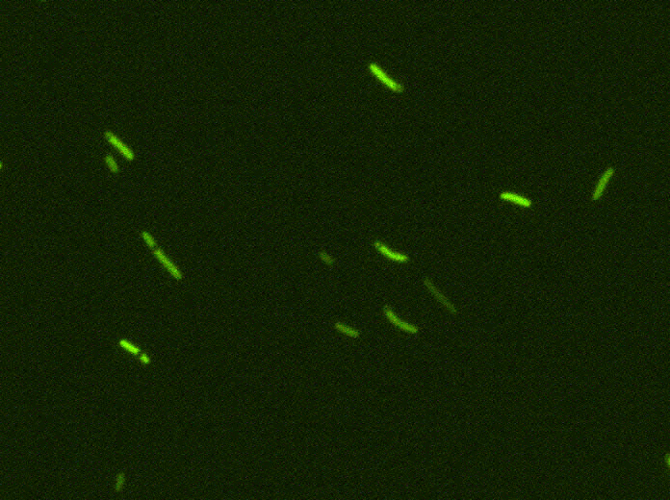
TASBE Tool-Chain
Resulting cells demonstrating expected behavior
Uninduced
Uninduced
If detect explosives:
emit signal
If signal > threshold:
glow red
Induced
Induced
Mammalian Target
E. coli Target
[Beal et al., 2012]

Slide 29
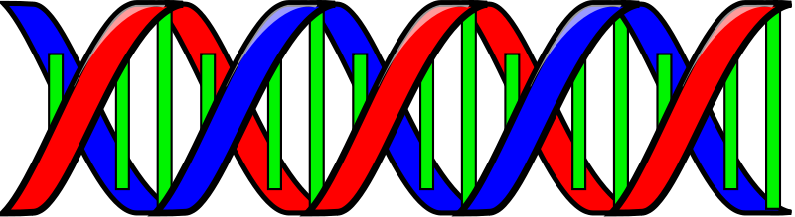
Challenge: Synthetic Device Libraries
Can use a device only once/circuit
→ need lots of devices!
Zinc-Finger Proteins:
micro RNAs:
TALE Proteins:
CRISPR: CAS/gRNA:

Slide 30
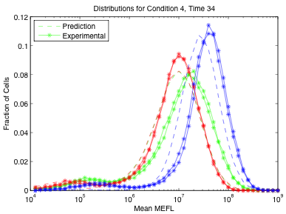
Challenge: Predictable Composition
Improved models & metrology
→ high-precision circuit prediction
Two-Repressor Cascade
Three-Replicon Mixture
[Davidsohn et al., 2013]

Slide 31
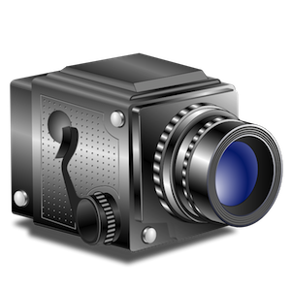
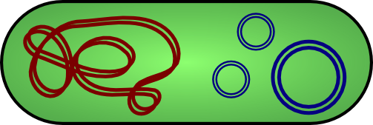
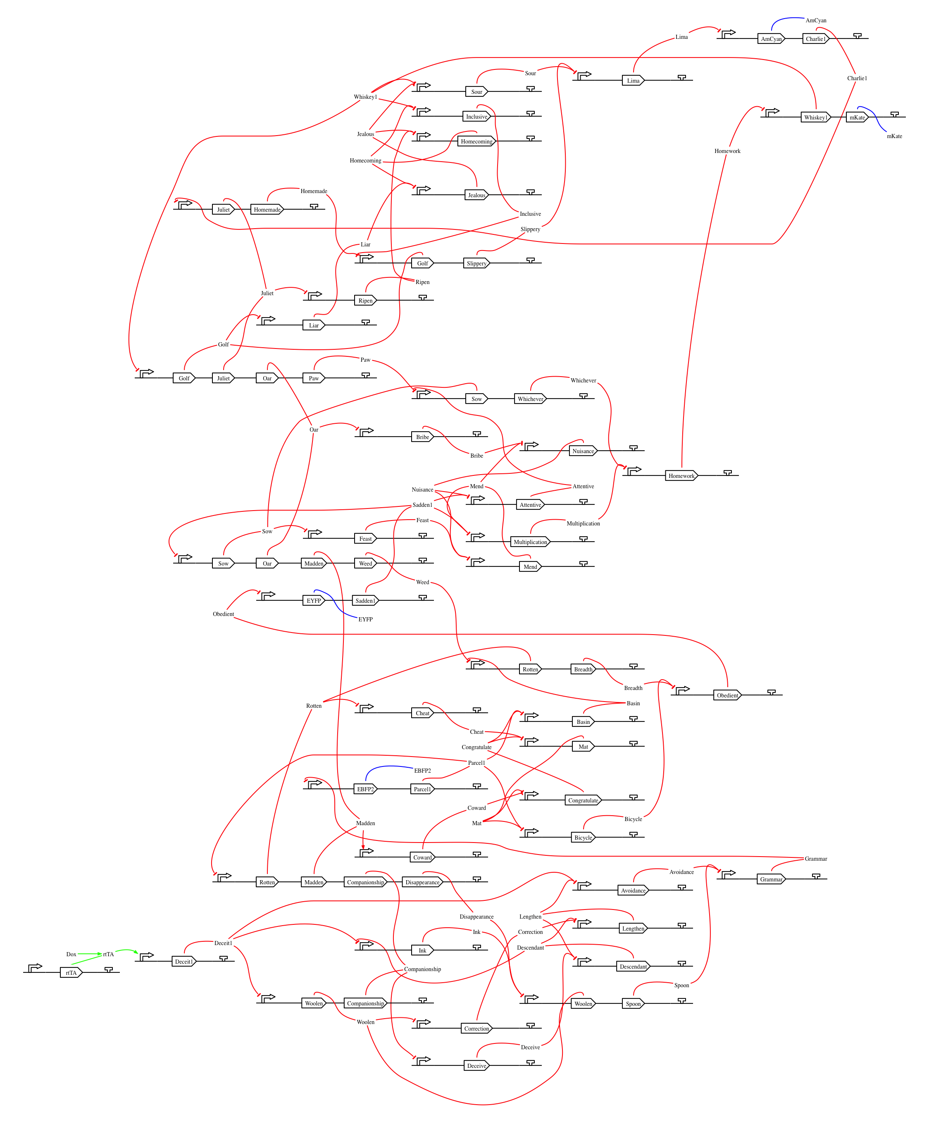
Biological/Hybrid Substrates: where we stand
P R
P R
P R
P R
P R
High-level specification
of complex circuits
P R
P R
P R
P R
P R
P R
P R
P R
P R
P R
Large, well-characterized
device libraries
Biological / Hybrid
Computing
Substrate
Precise circuit prediction
Electronics interface: optogenetic, electrical, magnetic, …

Slide 32
Summary
Major technological trends are all driving towards a world filled with spatial computers
Continuous space-time models allow effective adaptive aggregate programming.
Mixed-material computation will enable a wide range of visionary applications.
Rapid progress towards predictable, scalable computational control of biological organisms

Slide 33






Acknowledgements:
Aaron Adler
Brett Benyo
Taylor Campbell
Joseph Loyall
Rick Schantz
Kyle Usbeck
Fusun Yaman
Ron Weiss
Jonathan Babb
Noah Davidsohn
Tasuku Kitada
Ting Lu
Douglas Densmore
Swapnil Bhatia
Traci Haddock
Evan Appleton
Chenkai Liu
Viktor Vasilev
Tyler Wagner
Mirko Viroli
Matteo Cascadei
Ferruccio Damiani

Slide 34
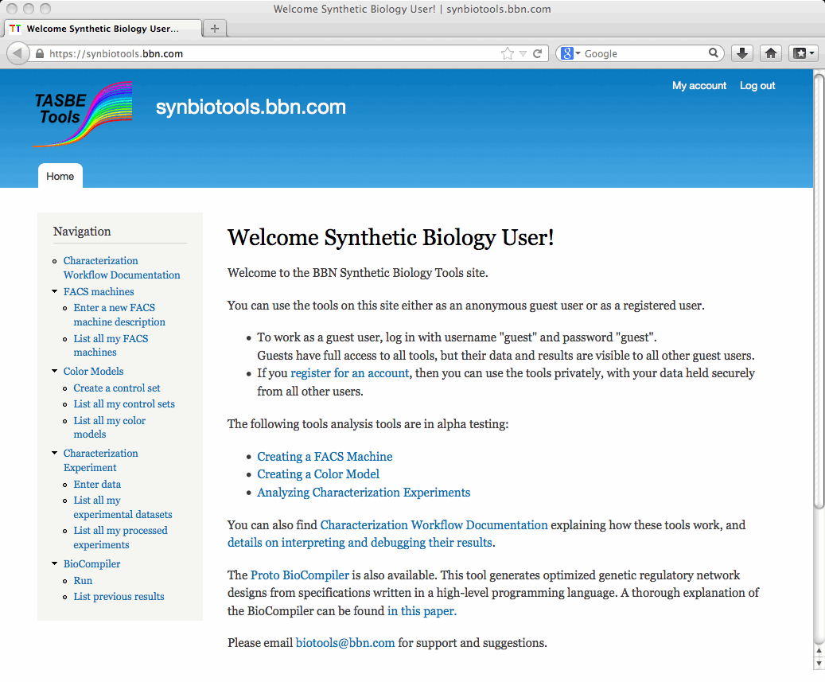
Tools available online!
http://proto.bbn.com/
http://synbiotools.bbn.com

